Slide 1
ONLINE CALCULATOR
20097 - Zeynep Salihoglu

Slide 2
PROJECT OVERVIEW
This project is a simple calculator application built using HTML, JavaScript. It allows users to perform basic arithmetic operations such as addition, subtraction, multiplication, and division, along with handling parentheses for grouping operations. The calculator interface includes buttons for digits, operators, and a display screen to show the input and result.

Slide 3
OBJECTIVES
The primary objective of this project is to create an interactive web-based calculator that allows users to perform basic arithmetic operations.
The secondary objective is to provide a practical example to demonstrate the integration of HTML, CSS, and JavaScript in a small project.

Slide 4
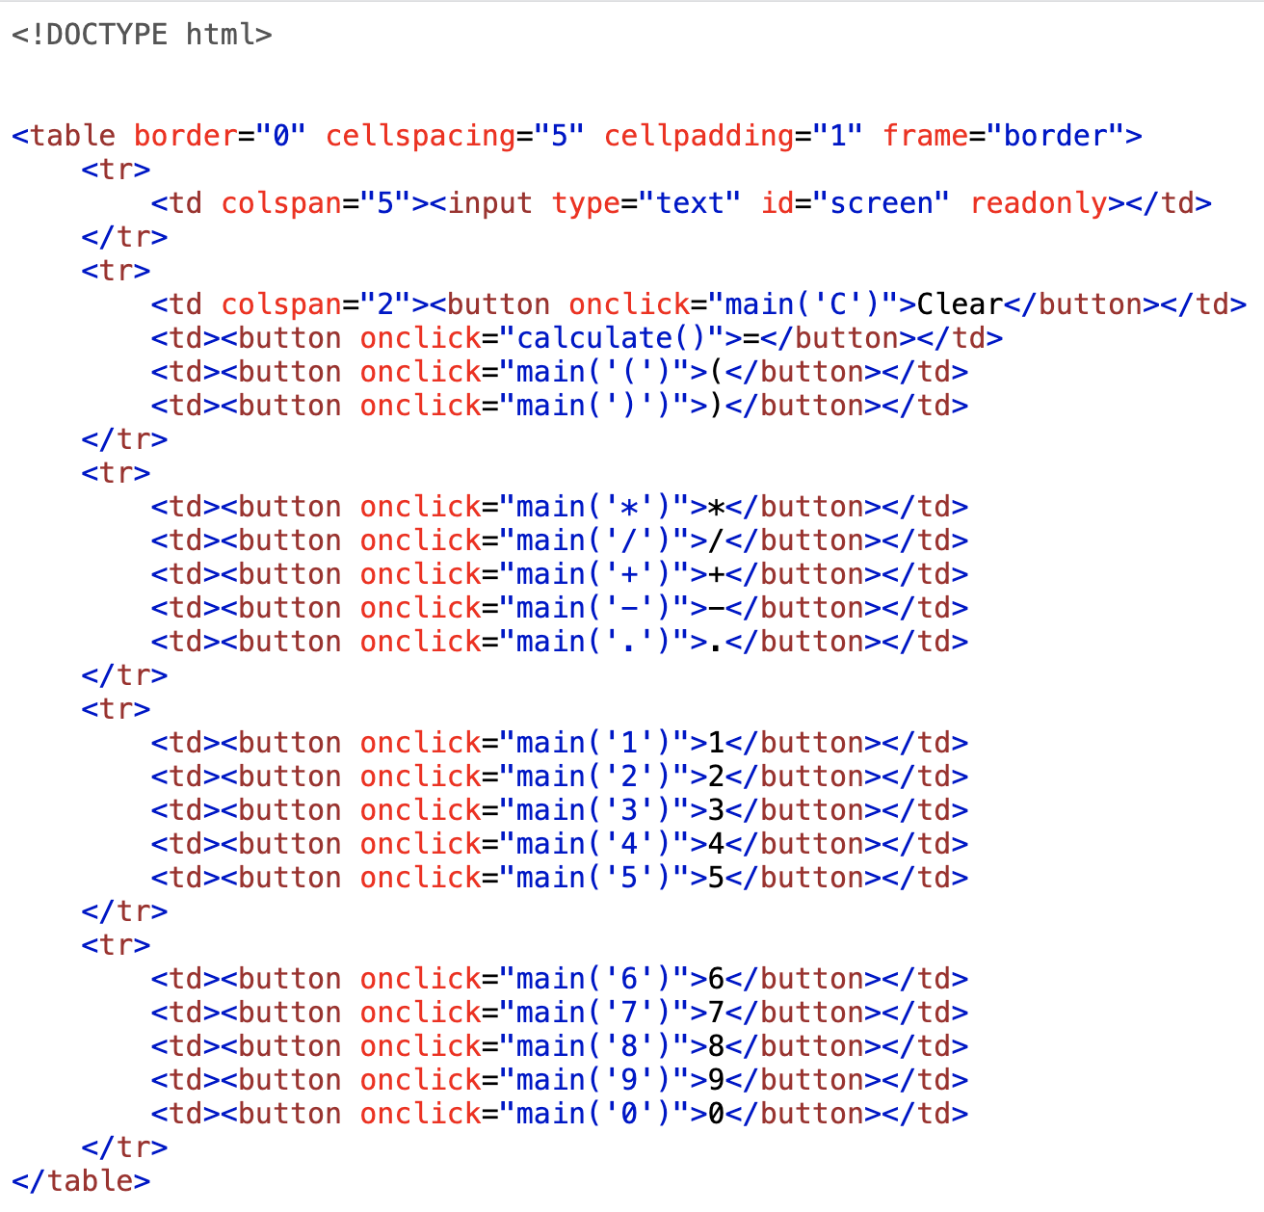
Create calculator layout
First row contains a single table data cell (<td>), which spans across 5 columns (colspan="5").
Second row has Clear button that calls main function and '(', ')' that calls main function. Also, '=' button that calls calculate function.
Other three rows have other operation buttons that calls main function.

Slide 5
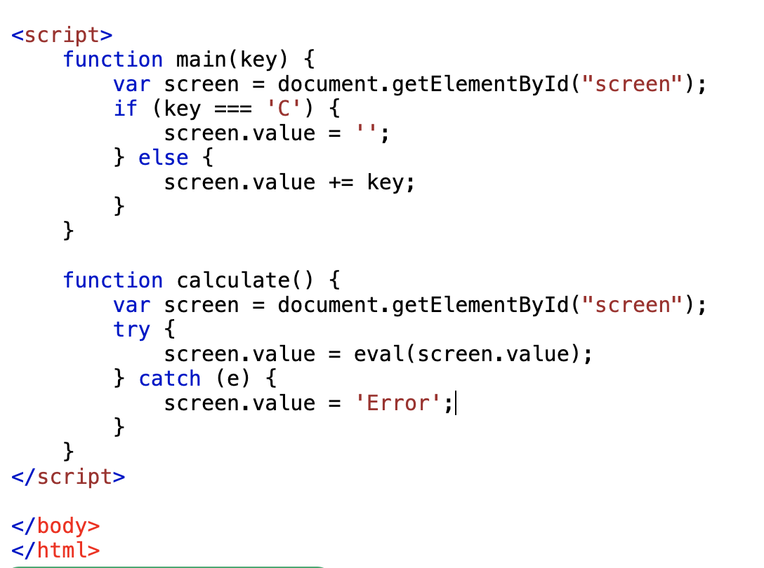
Main and calculate functions
Main function:
It gets the screen element using document.getElementById("screen").
If the key is 'C', it clears the screen by setting screen.value to an empty string.
Otherwise, it appends the key to the current value of the screen.
Calculate function:
It gets the screen element using document.getElementById("screen").
It tries to evaluate the expression using the eval function.
If an error occurs during evaluation (e.g., a syntax error), it catches the exception and sets the screen value to 'Error'.

Slide 6
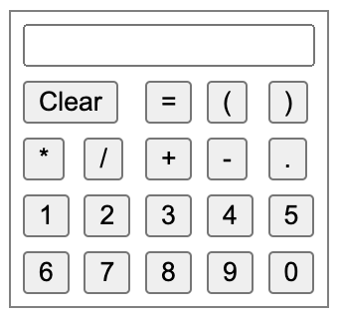
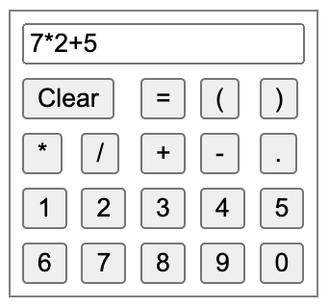
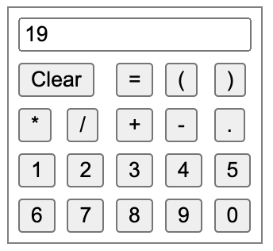
DESIGN IMAGES

Slide 7
ACHIEVEMENTS
Creating table in html.
Create buttons for different operations.
Using eval() function for evaluating mathematical expressions input by the user, as these expressions are naturally in string form.
Display the current input and results on the screen.
displays an error message in response to invalid input expressions.

Slide 8
CONCLUSION
Perform calculations involving addition, subtraction, multiplication, and division.
Use parentheses to group operations and control the order of evaluation.
Clear the input screen and reset the calculator.

Slide 9
REFERENCES
https://hc.labnet.sfbu.edu/~henry/npu/classes/javascript/html5/slide/table_example.html
https://hc.labnet.sfbu.edu/~henry/npu/classes/javascript/html5/slide/exercise_html5.html#cl
https://www.w3schools.com/tags/tryit.asp?filename=tryhtml_button_test

Slide 10
THANK YOU!

